Slide 1

Magic methods and constants
By Min Thet Naing

Slide 2
The __construct magic method
By Min Thet Naing

Slide 3
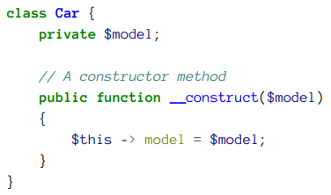

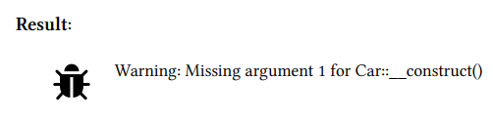
By Min Thet Naing

Slide 4
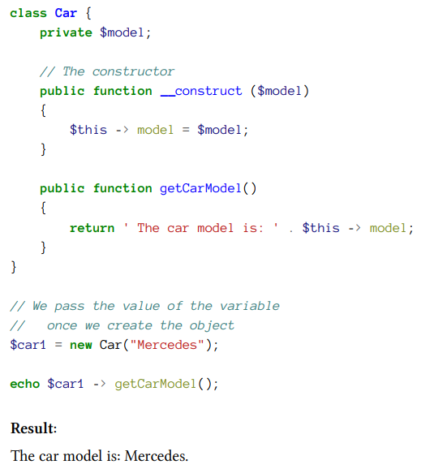
By Min Thet Naing

Slide 5
How to write a constructor method without risking an error?
By Min Thet Naing

Slide 6
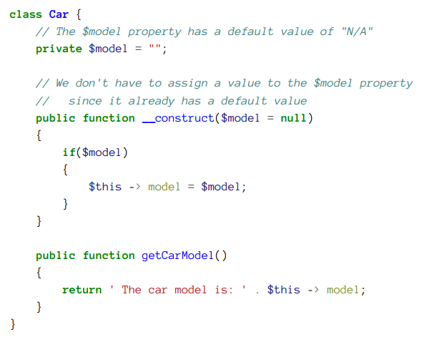
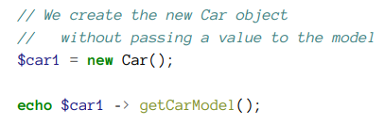

By Min Thet Naing

Slide 7
Magic constants
By Min Thet Naing

Slide 8
__CLASS__ magic constant
By Min Thet Naing

Slide 9
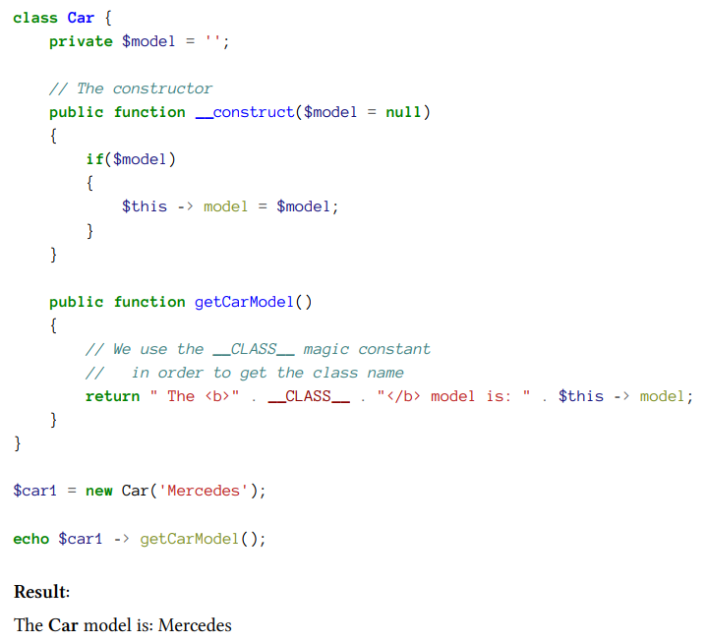
By Min Thet Naing

Slide 10
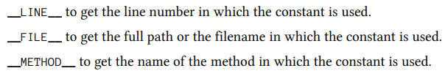
By Min Thet Naing

